Slide 1

Engagement that leads to Stewardship
Chuck Grahmann, St Thomas More Parishioner, CFU Board member, Proud Papa
Elizabeth Kirts, St. Thomas More Parish Council President

Slide 2
Overview
Our parish was struggling with growing membership and raising money. With the leadership of our Pastor, we agreed that making our parish more Welcoming was our #1 goal.
We will discuss how this unfolded over time.

Slide 3

Agenda
Driving Engagement
Welcoming as the #1 Goal
Tactics Used
Key Team
Summary

Slide 4

So what is Engagement?
In business, having engaged employees is a top goal.
They are invested in the success of the business and bring their whole self to the role (Time and Treasure)
They demonstrate their commitment through their thoughts, feelings and actions (Talent)
They show up with a sense of purpose, dedication and are seeking collaboration (Time and Talent)
Notes:
Chuck wrote these slides with a business model in mind. I come from management with a healthcare background. Sometimes there is a little more empathy and altruism in this field. But a key thing to remember is that in our parishes we are working with volunteers and not employees. They can at any time chose not to continue. They are also doing it for their own personal reasons and not because they need the job.

Slide 5
How do the ‘best’ parishes feel?
2nd Home
I was Engaged*
I was accepted
It was fun!
I felt welcome
2nd most important commandment: Love thy neighbor as thyself.
Matthew 22-36:40
*Engagement – at a Parish – is observed by generously giving of one’s Time, Talent and Treasure
Notes:
Love thy neighbor, we don’t always love people we work with or volunteer with. What we need to do is have a respect for the fact that they are putting in that time.

Slide 6
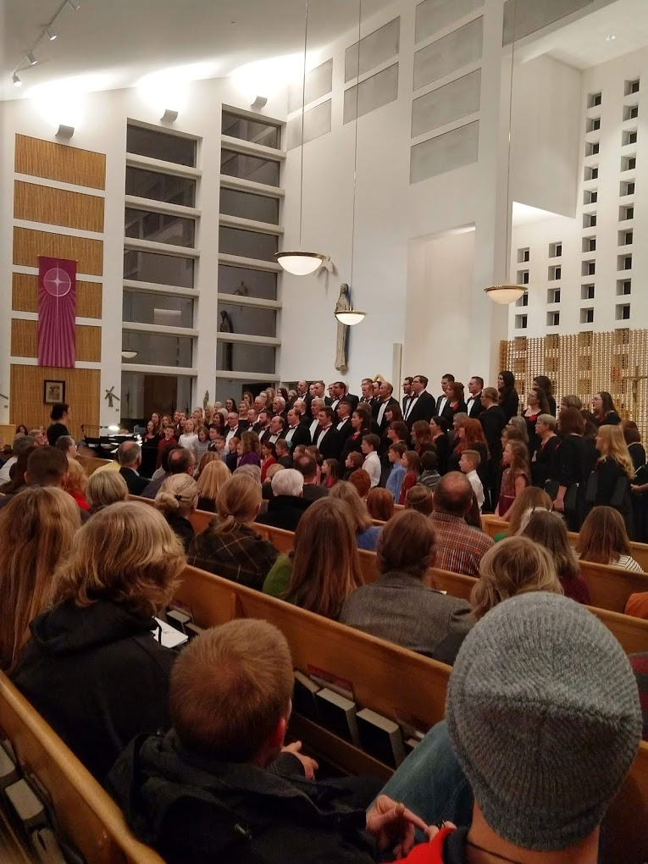
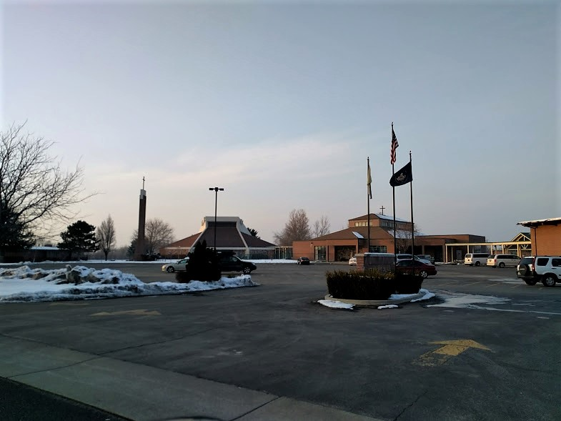
‘From the Parking Lot to the Pews’
Notes:
We use this phrease at ST. Thomas a lot. Some of the people are the veni vedi vichi parishoners. How do we pull them in?

Slide 7

As our #1 goal
Welcoming that leads to Fellowship
Notes:
For many people there is a need for very direct/individual/personal welcoming and inviting them to attend events. There are some people who if “called out” will shrink withing themselves and not come back.

Slide 8
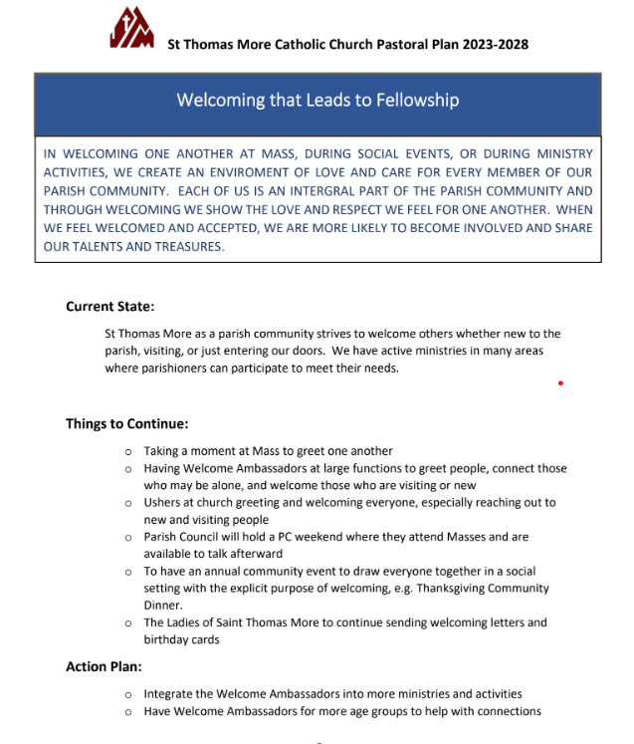
Tactic #1
Put it in the Parish Pastoral Plan - and align!
Notes:
Welcoming at Mass
Ambassadors
PC weekend
Community Event
“free events”
Welcoming letters

Slide 9
Tactic #2
First Contact: From Ushers to Hospitality Ministers
Pre:
Finding seats/moving baskets is basic
Less time talking to one another vs others
Post:
Training on being outgoing and engaging
Opening doors, saying good morning
‘That’s my favorite team’ or ‘I love those shoes!’
Welcome, welcome, welcome!

Slide 10
Tactic #3
FREE events that build our sense of community - ‘All are Welcome’
In started with:
Knights free breakfast after mass… Everyone came over and donations paid for the whole cost!
Post:
Annual Feast of St Thomas More
Annual Free Spaghetti Dinner / Cinco de Mayo
Integration of ‘Welcoming Ambassadors’
Examples: spaghetti dinner, new parishioner at Thanksgiving, widower

Slide 11
Tactic #4
Little things add up…
Our priest asking everyone to turn and greet the person next to them and ask their name…
The Parish Council leading an annual ministry fair to grow engagement
Welcoming packet sent to all new parishioners
Monthly Donut Sunday hosted by Ladies, Parish Council, ‘New’ Knights, Respect for Life
Ladies Example: Nancy Hardy and Annette Pressley

Slide 12
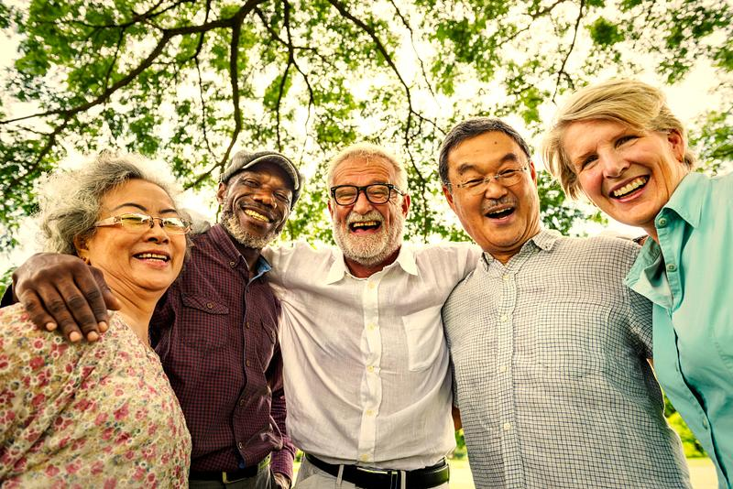
Tactic #5
Support each volunteer, follow your passions, and have fun!

Slide 13
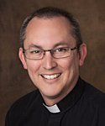
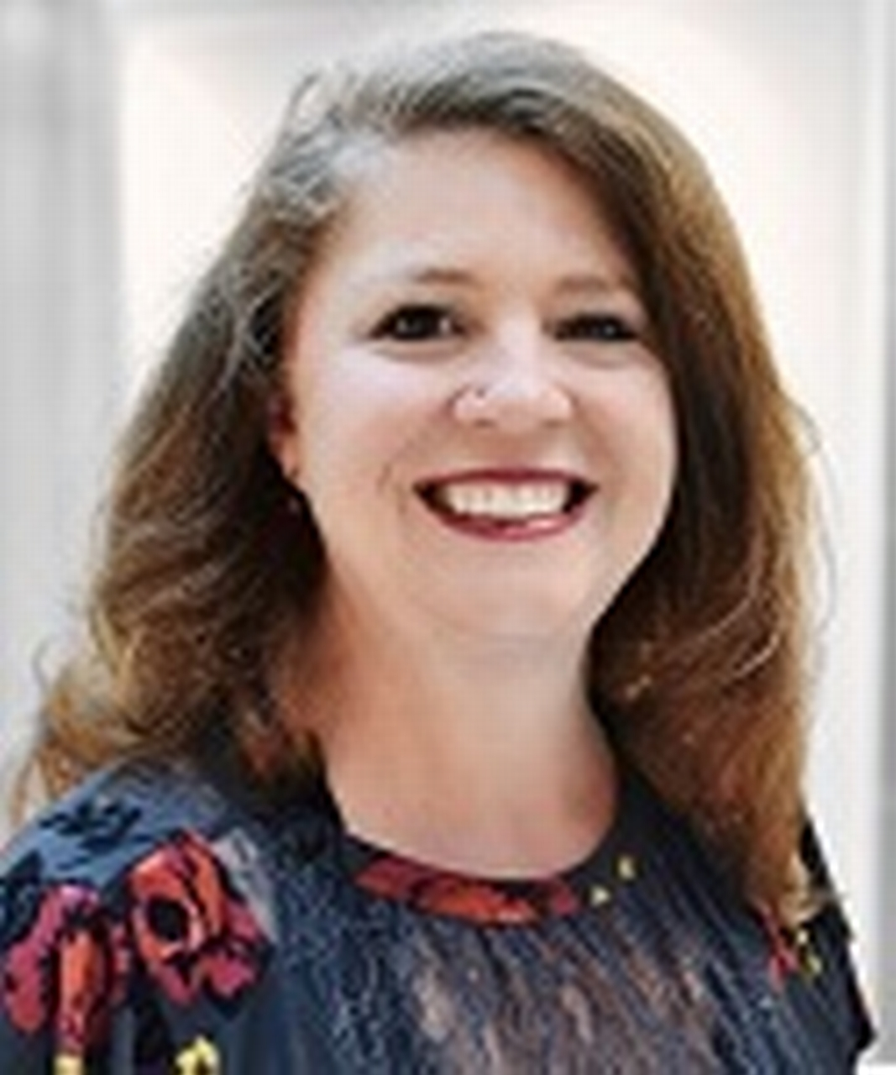
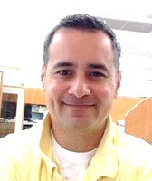
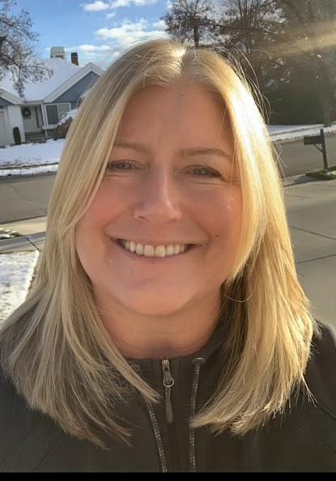
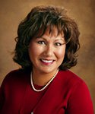
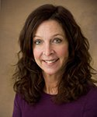
Meet our team
Father John Evans
Liz
Kirts
Chris
Lentz
Missy
Corcoran
Pastor
President Parish Council
Grand Knight, KofC 11479
President, Ladies
Nora
Kennedy
Tami
Bernstein
Front Office
Director of Religious Education

Slide 14
Summary
Our parish was struggling with growing membership and raising money. With the leadership of our Pastor, we agreed that making our parish more Welcoming was our #1 goal.
We think it has made a difference based on the feedback of new and old parishioners alike, ultimately leading to greater involvement, greater giving, and greater faith formation.

Slide 15

Questions?
Chuck Grahmann​
801 673 0238 / cgrahmann1@gmail.com
Elizbeth Kirts
801-556-5909/ Elizabeth.kirts@hsc.Utah.edu

